Slide 1
NLP in Action
Gelar Rasa 2023 @ UPN “VETERAN” JAWA TIMUR
Salahuddin Muhammad Iqbal
2023-11-11
https://s.id/1Wu7W

Slide 2
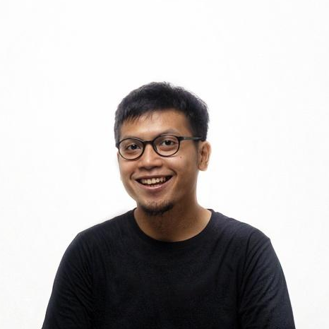
About Me
Works
株式会社FastLabel (~present)
株式会社Inbound Technology
Zero One Group
PT. WISH
Educations
Dongseo University
Politeknik Elektronika Negeri Surabaya
Salahuddin Muhammad Iqbal
@ivokun

Slide 3
Classification
Sentiment Analysis

Slide 4
Classification
"Congratulations! You've won a $1000 gift card. Claim now at www.winbig.com."
"Urgent! Your account has been compromised. Please send your password to secureyouracct@example.com to protect your account."
"Meet singles in your area tonight. Sign up at www.lovesingles.com for an unforgettable experience!"
"Limited time offer! Buy one get one free on all our skincare products. Visit www.beautydeals.com."
"Hello, this is a friendly reminder about your appointment with Dr. Smith tomorrow at 3 pm."
"Don't miss our exclusive webinar on investment strategies. Reserve your spot at www.financewebinar.com."

Slide 5
Classification
"Congratulations! You've won a $1000 gift card. Claim now at www.winbig.com."
"Urgent! Your account has been compromised. Please send your password to secureyouracct@example.com to protect your account."
"Meet singles in your area tonight. Sign up at www.lovesingles.com for an unforgettable experience!"
"Limited time offer! Buy one get one free on all our skincare products. Visit www.beautydeals.com."
"Hello, this is a friendly reminder about your appointment with Dr. Smith tomorrow at 3 pm."
"Don't miss our exclusive webinar on investment strategies. Reserve your spot at www.financewebinar.com."

Slide 6
Classification
Input
Normalization
Stop Words Removal
Tokenization
Embedding
SVM
Output

Slide 7
Classification
Embedding
❌
Input: [0, 1, 2, 3, 4]
Input:
[
[1, 0, 1, 0, 0, 0],
[1, 1, 1, 0, 0, 0],
…,
[0, 0, 0, 1, 1, 1],
]
⚠️
Input:
[
[0.12.., 0.2…, 0.3…, …, 0.2..],
[0.2.., 0.2…, 0.1…, …, 0.2..],
…,
[0.1.., 0.1…, 0.3…, …, 0.2..],
]
✅

Slide 8
Classification
Embedding
Word2Vec
GloVe
Elmo
Bag of Words
TF-IDF
BERT

Slide 9
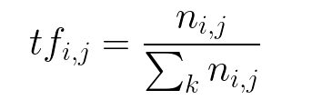
Classification
Embedding
TF-IDF
TF(w)=(Number of times term w appears in a document)/(Total number of terms in the document)

Slide 10
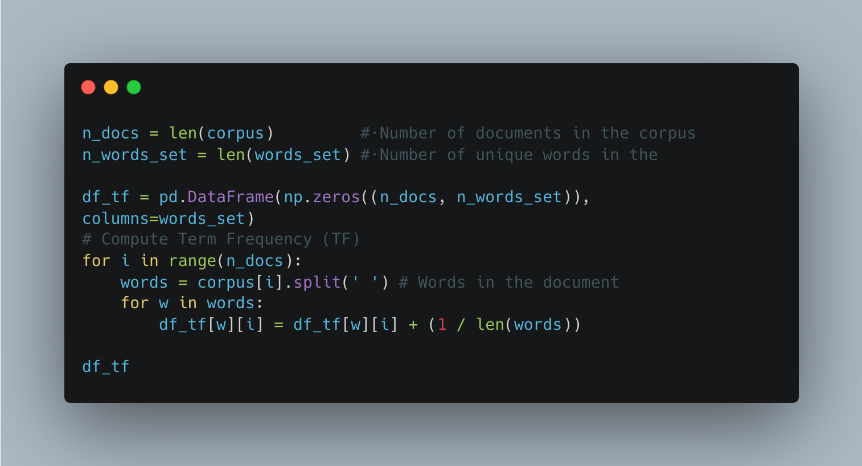
Classification
Embedding
TF-IDF

Slide 11
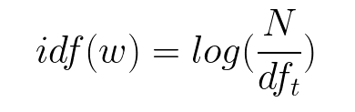
Classification
Embedding
TF-IDF
IDF(w)=log ​
(Total number of documents/Number of documents with term w in it)

Slide 12
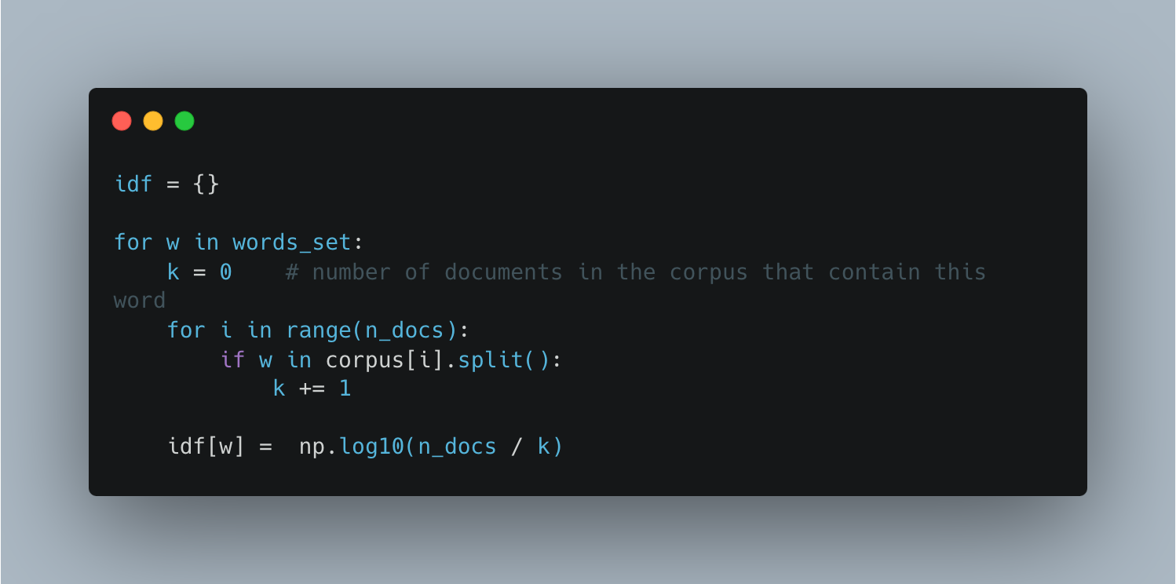
Classification
Embedding
TF-IDF

Slide 13
Classification
Embedding
TF-IDF
TF-IDF(t)=TF(t)×IDF(t)

Slide 14
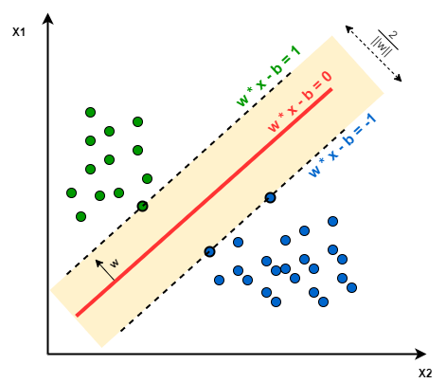
Classification
SVM

Slide 15
Sentiment Analysis
"I absolutely loved the friendly staff and the cozy atmosphere of the cafe!"
"I'm really disappointed with the quality of the product - it broke after one week."
"The movie was a groundbreaking success and a marvel of modern cinema."
"Honestly, I've had better meals; the food was bland and unremarkable."
"The customer service was unhelpful and rude, which ruined my entire shopping experience."
"Stunning views from the hotel room made my vacation unforgettable."

Slide 16
Sentiment Analysis
😍
"I absolutely loved the friendly staff and the cozy atmosphere of the cafe!"
"I'm really disappointed with the quality of the product - it broke after one week."
"The movie was a groundbreaking success and a marvel of modern cinema."
"Honestly, I've had better meals; the food was bland and unremarkable."
"The customer service was unhelpful and rude, which ruined my entire shopping experience."
"Stunning views from the hotel room made my vacation unforgettable."
☹️
😍
☹️
😡
😍

Slide 17
Is my model performs well?....
Accuracy
Precision
Recall
F1-Score

Slide 18

Is my model performs well?....
Accuracy
SPAM (50)
HAM (50)

Slide 19
Is my model performs well?....
Accuracy
SPAM (1000)
HAM (50)

Slide 20
Is my model performs well?....
 | Positive | Negative
True | TP | TN
False | FP | FN

Slide 21

Is my model performs well?....
Precision

Slide 22

Is my model performs well?....
Recall

Slide 23

Is my model performs well?....
F1-Score

Slide 24

NLP ❤ Deep Learning

Slide 25
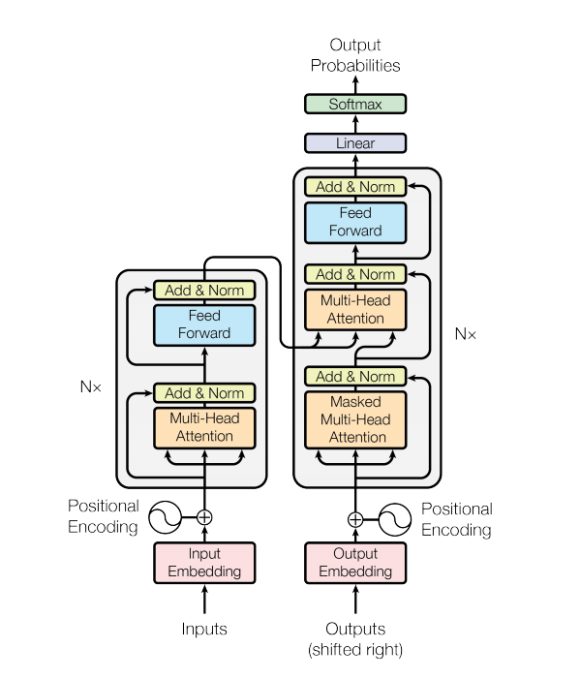
NLP ❤ Deep Learning
Transformer
(attention is all you need)
https://jalammar.github.io/illustrated-transformer/

Slide 26
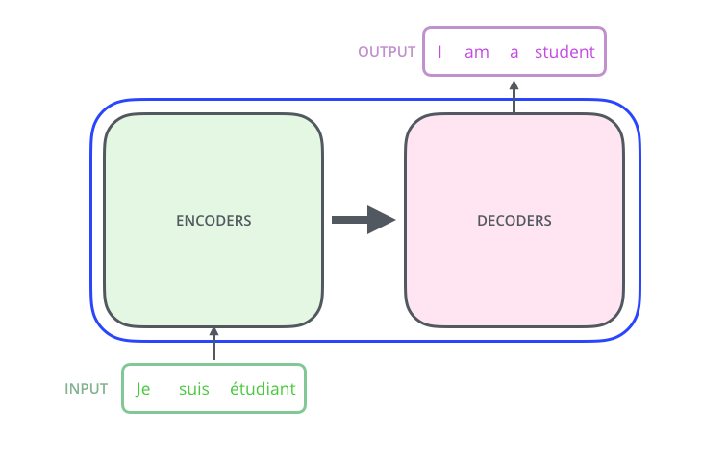
NLP ❤ Deep Learning
Transformer
(attention is all you need)
https://jalammar.github.io/illustrated-transformer/

Slide 27
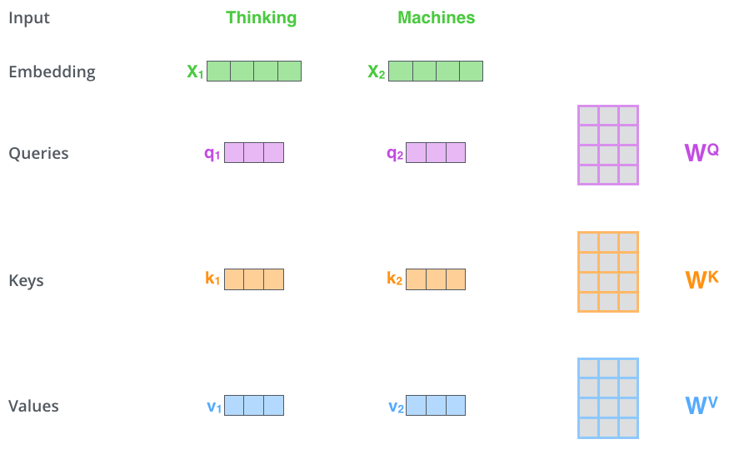
NLP ❤ Deep Learning
Transformer
(attention is all you need)
https://jalammar.github.io/illustrated-transformer/

Slide 28
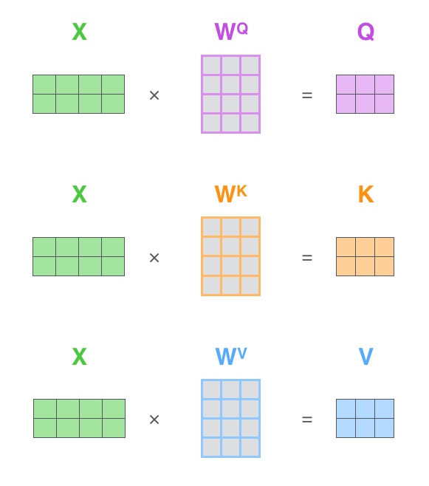
NLP ❤ Deep Learning
Transformer
(attention is all you need)
https://jalammar.github.io/illustrated-transformer/

Slide 29
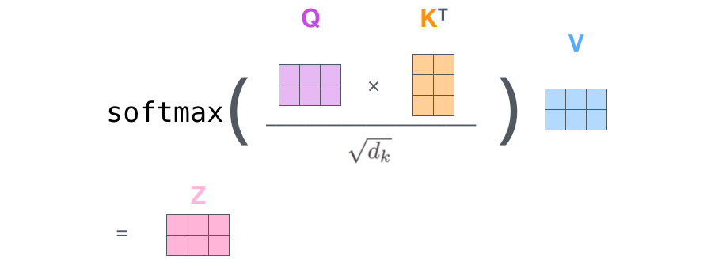
NLP ❤ Deep Learning
Transformer
(attention is all you need)
https://jalammar.github.io/illustrated-transformer/

Slide 30
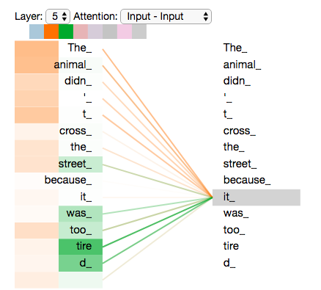
NLP ❤ Deep Learning
Transformer
(attention is all you need)
https://jalammar.github.io/illustrated-transformer/

Slide 31

NLP ❤ Deep Learning

Slide 32
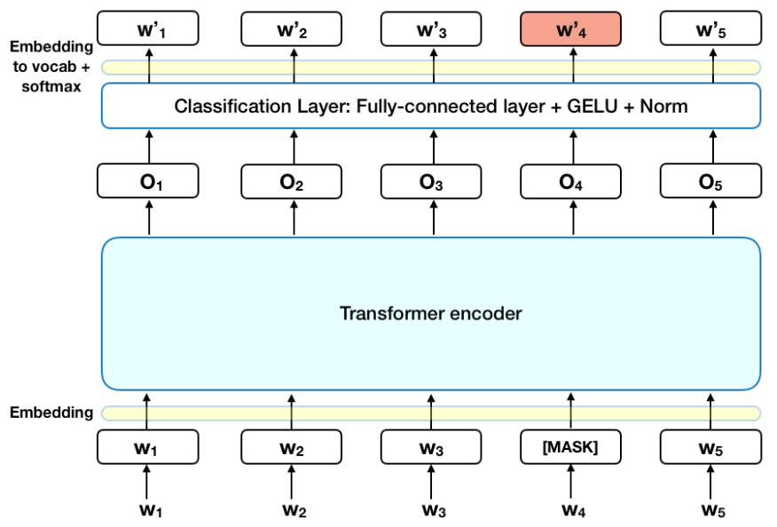
NLP ❤ Deep Learning

Slide 33
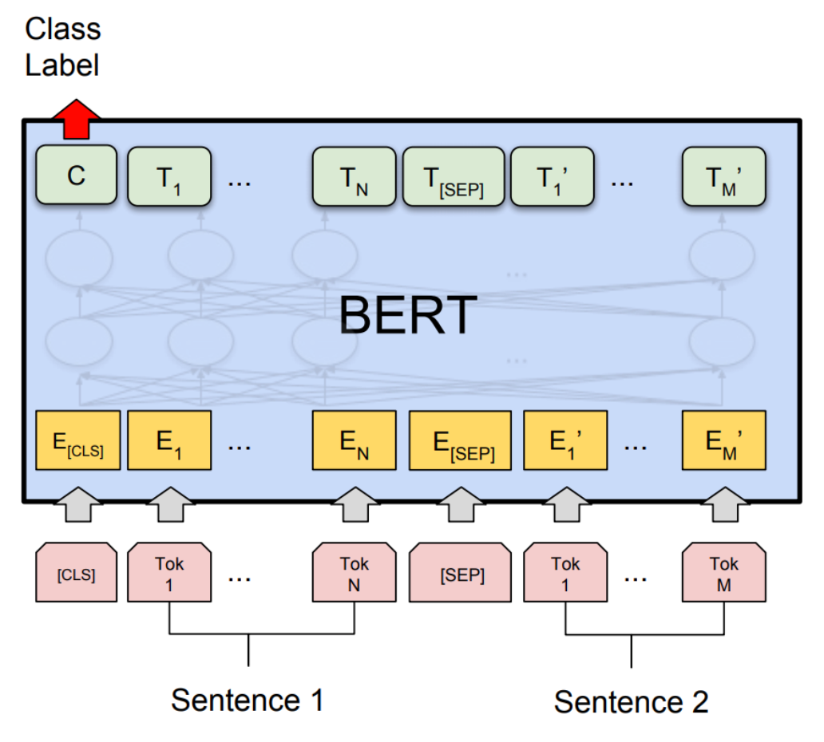
NLP ❤ Deep Learning

Slide 34
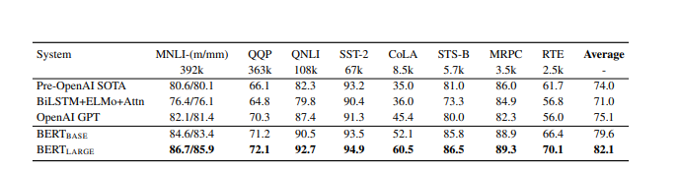
NLP ❤ Deep Learning

Slide 35
NLP 🤗 Deep Learning
https://github.com/huggingface/transformers
https://huggingface.co/docs

Slide 36
Resources
https://radimrehurek.com/gensim/
https://spacy.io/
https://www.nltk.org/
https://scikit-learn.org/stable/
https://huggingface.co/docs/transformers/

